Slide 1
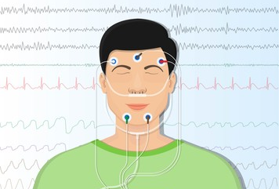
Neural ODE for Sleeping Stage Identification
Itamar Meyer Orel Tsioni
Supervisor: Ms. Ya-Wei Lin

Slide 2

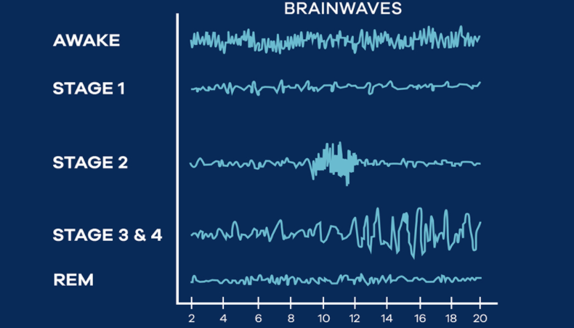
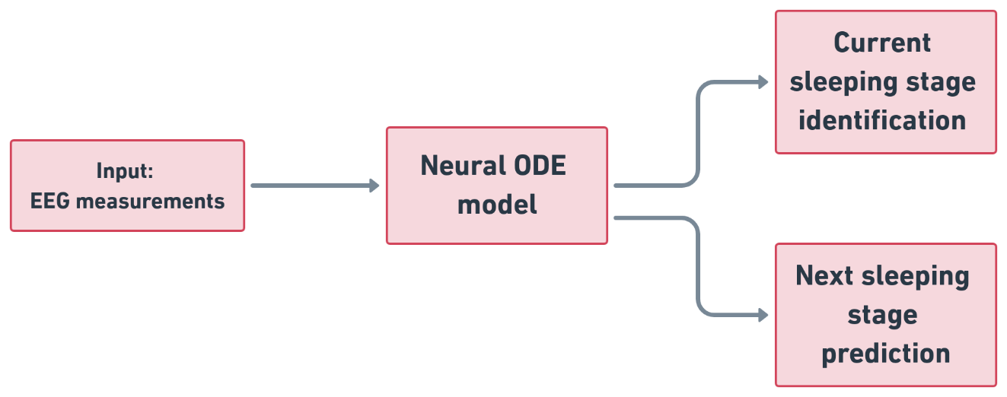
Main goal
Main purpose - Feed data to the model and see the performance of our model in classifying and predicting sleeping stages.
The data is a time series of EEG measurements during people sleeping time.
Neural ODEs are neural network models which generalize standard layer to layer propagation to continuous depth models.
Notes:
We first want to talk about our main task and the model we intend to use to accomplish that task and analyzing the results.
To talk about the task we will first talk briefly about our data. Our data is EEG measurements from multiple subjects during their sleeping time.
During sleeping time people

Slide 3

Agenda
Introduction to Neural Ordinary Differential Equations
ResNet
ResNet and Euler method
From ResNet to Neural Ordinary Differential Equations
Modeling Rates of Change
Neural ODE Loss and Forward Pass
Adjoint Sensitivity Method
Training and Backward Pass
Benefits and paper results
The data
Basic model and preliminary results
Next steps

Slide 4
Neural Ordinary Differential Equations
Neural ODE – One of the best paper awards in NeuralPS 2018
What does it contain?
Description of solving neural with ODE solver
A backpropogation algorithm for ODE solver
Generative process
Continues normalized flow
arXiv:1806.07366 , Chen et al.
Note: Red is not covered up with this presentation
Notes:
NeuralIPS=Conference on Neural Information Processing Systems

Slide 5
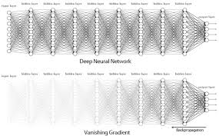
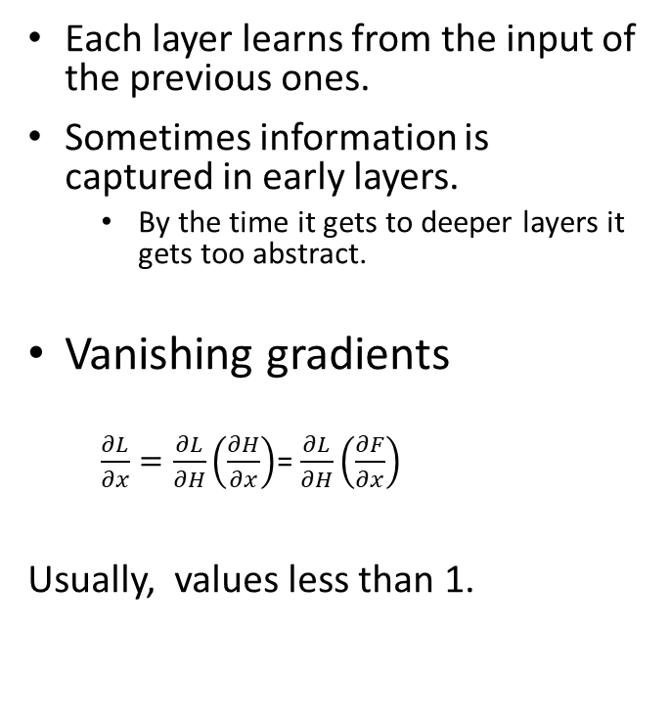
Deep Neural networks
Each layer learns from the input of the previous ones.
Sometimes information is captured in early layers.
By the time it gets to deeper layers it gets too abstract.
Vanishing gradients
$\frac{∂L}{∂x}=\frac{∂L}{∂H}\left(\frac{∂H}{∂x}\right)$= $\frac{∂L}{∂H}\left(\frac{∂F}{∂x}\right)$
Usually, values less than 1.
Notes:
To start talking about ResNet, first let’s talk about the necessity of it when facing few problems in deep neural networks.
1. backpropagation is about understanding how changing the weights (parameters) in a network changes the loss function by computing the partial derivatives.
It’s really worth noticing that all these values are often less than 1, independent of the sign. In order to propagate the gradient to the earlier layer’s, backpropagation uses multiplication of the partial derivatives (as in the chain rule). the gradient of the network gets smaller and smaller.
Evidence show that deeper convolutional NNs allow the model to become richer and more expressive, thus enabling it to approximate a bigger family of elaborated functions.
With that, one can not simply add infinite number of layers to his network, because it causes 2 major issues: vanishing gradients and accuracy saturation.
2. adding more layers, while theoretically increasing the ability of the network to learn, can actually decrease the accuracy of it, both in training and test results.
3. This problem was adressed by Deep Residual Learning, from Kaiming He, Xiangyu Zhang, Shaoqing Ren, and Jian Sun out of Microsoft Reasearch. (move to next slide)

Slide 6
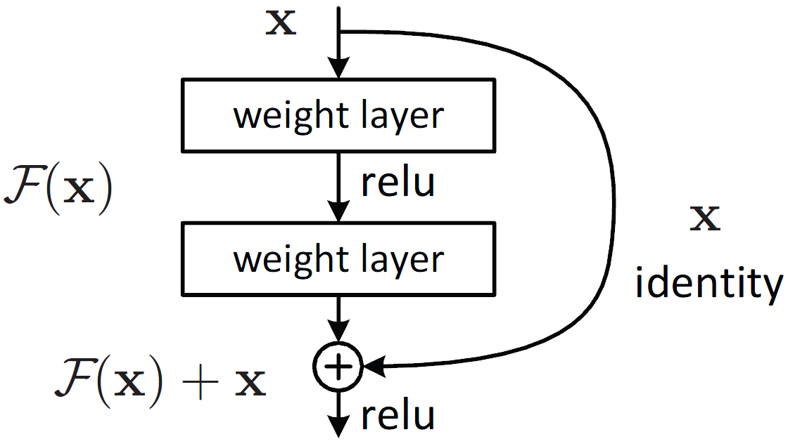
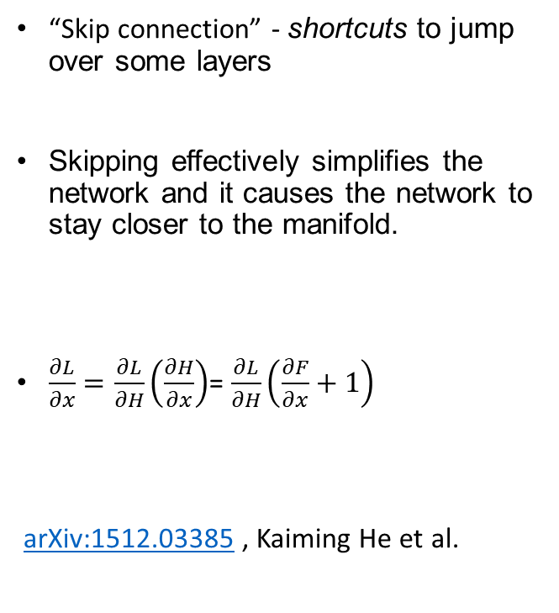
ResNet – Deep residual learning for image recognition
“Skip connection” - shortcuts to jump over some layers
Skipping effectively simplifies the network and it causes the network to stay closer to the manifold.
$\frac{∂L}{∂x}=\frac{∂L}{∂H}\left(\frac{∂H}{∂x}\right)$= $\frac{∂L}{∂H}\left(\frac{∂F}{∂x}+1\right)$
arXiv:1512.03385 , Kaiming He et al.
Notes:
The idea in a nutshell is to learn a function of the difference between layers.
1. This is done by adding something called a “skip connection”. This is a shortcut to jump over some layers. This way we can represent the stream of data as a series of changes from the previous state.
it could also make it easier to represent for a neural network thus, help the network output to stay close to the manifold. ResNet is a concatenation of this residual blocks with “skip connection”.
This also make later layers learn from the early layers input. Main benefit of resnet is solving the vanishing gradient issue. This means that we can use more layers and really make use of deeper neural networks with a better generalization capabilities.
Transition line:
Then what is the connection to ODEs?

Slide 7
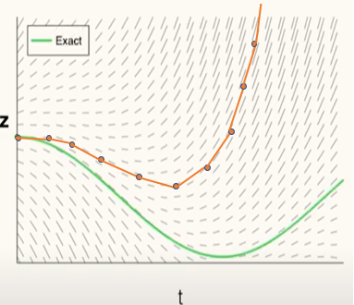
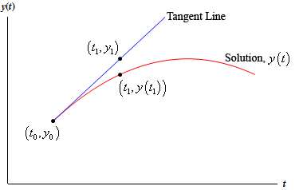
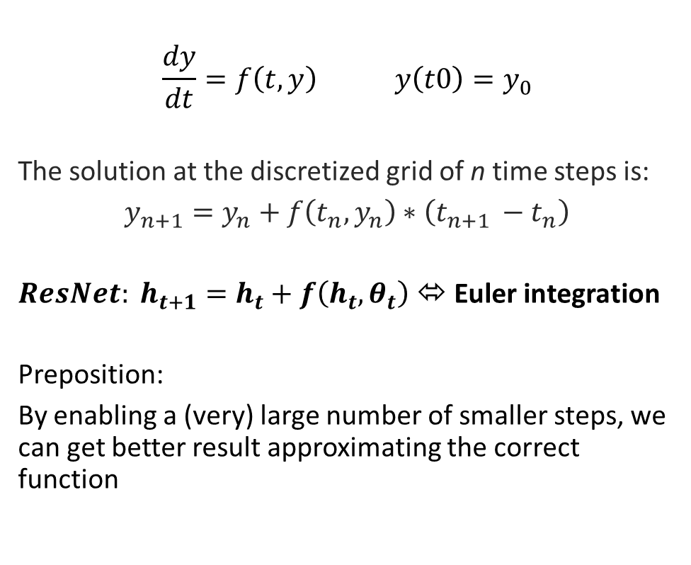
ResNet and Euler method
$$\frac{dy}{dt}=f\left(t,y\right) y\left(t0\right)=y_{0}$$
The solution at the discretized grid of n time steps is:
$y_{n+1}=y_{n}+f\left(t_{n},y_{n}\right)∗\left(t_{n+1 }−t_{n}\right)$
${ResNet: h}_{t+1}=h_{t}+f\left(h_{t},θ_{t}\right)$ ⬄ Euler integration
Preposition:
By enabling a (very) large number of smaller steps, we can get better result approximating the correct function
Notes:
Let’s see a numerical way to solve ODEs called Euler method also called forward Euler method.
It is the simplest method from a family of methods for solving ODEs numericaly called Runge–Kutta method.
The Euler method is a first-order method, which means that the local error (error per step) is proportional to the square of the step size, and the global error (error at a given time) is proportional to the step size.
2. This is what is done in residual blocks in ResNet. The y_{n+1} = y_n + f(t_n, y_n) is nothing but a residual connection in ResNet, where the output of some layer is a sum of the output of the layer f() itself and the input y_n to this layer. We See how we can follow the function trajectory with a local error and let the network learn the trajectory.
3. a chain of residual blocks in a neural network is basically a solution of the ODE with the Euler method! In this case, the initial condition for the system is “time” 0, which indicates the very first layer of the neural network, and as x(0) will serve the normal input, which can be time series, image, whatever you want! The final condition at “time” t will be the desired output of the neural network: a scalar value, a vector representing classes or anything else
Transition:
Knowing that Euler method is kind of a primitive way and not so accurate to solve ODEs we can try to make it better by taking a smaller steps with a denser grid.
Let’s understand before we continue why we want to solved ODEs and how approximating the derivative helps us to find the function we are looking for.

Slide 8
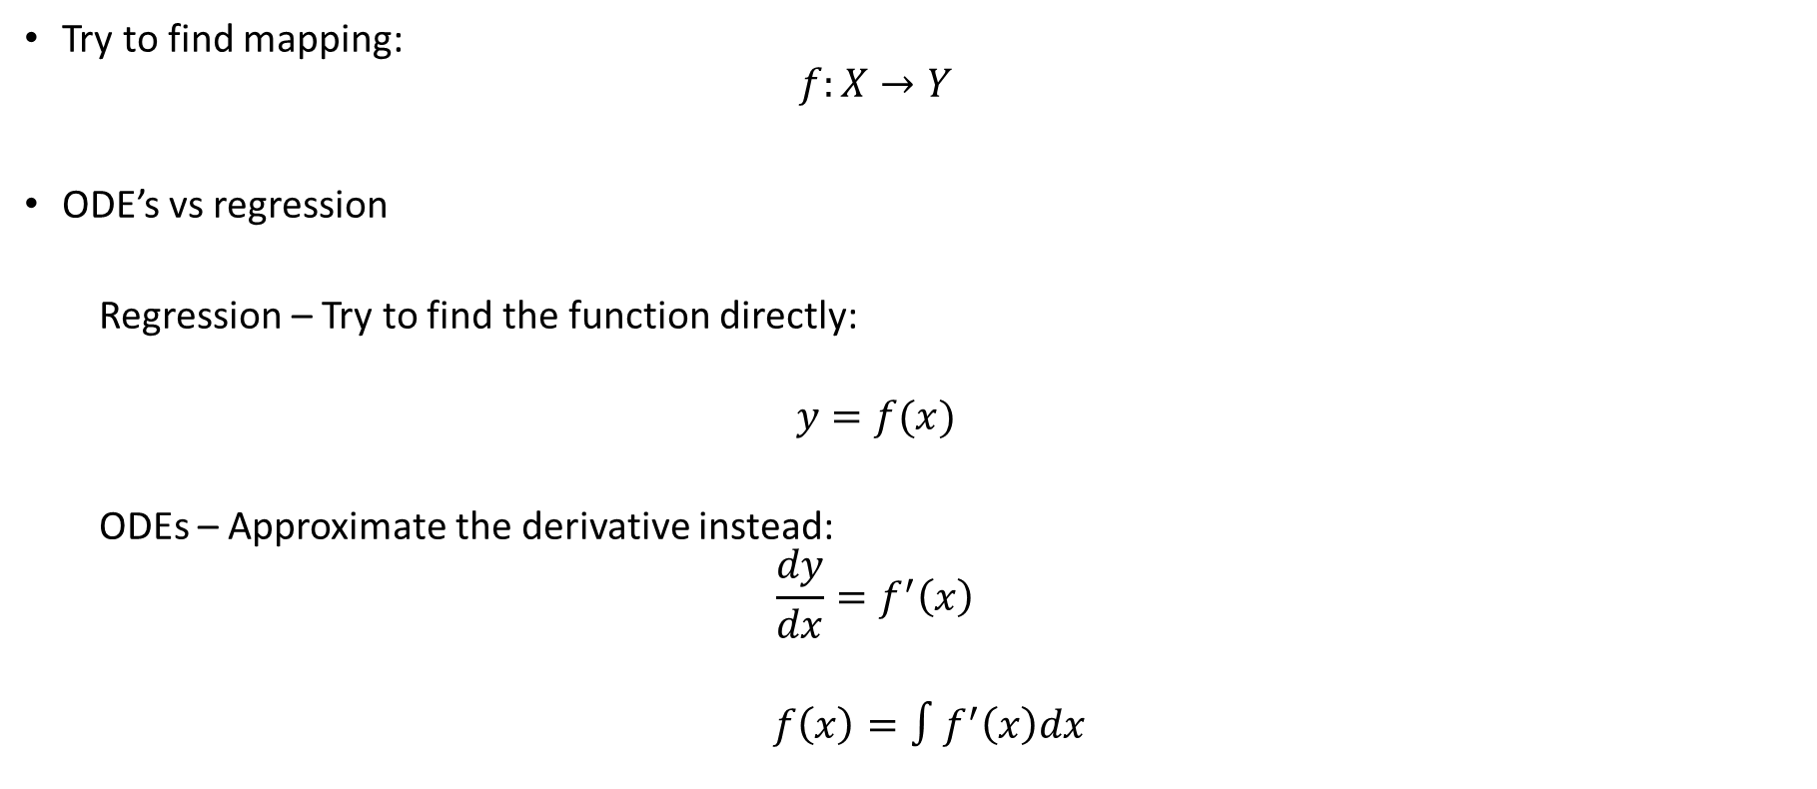
Modeling rates of change
Try to find mapping:
$$f:X→Y$$
ODE’s vs regression
Regression – Try to find the function directly:
$$y=f(x)$$
ODEs – Approximate the derivative instead:
$$\frac{dy}{dx}=f^{′}\left(x\right)$$
$f\left(x\right)=∫f^{′}\left(x\right)dx$
Notes:
So how exactly ODEs let us approximate a function.
For this we want to talk about two approaches for finding a function which sends points in X to points in Y.
There are two approaches: ODEs vs Regression.
1.In regression we try to find f directly. But if f is differentiable, what if we tried to find its derivative instead? This amounts to searching for f indirectly by differentiating the regression relationship.
2. This is a basic form of an ordinary differential equation, or an ODE. Solving the ODE is equivalent to solving the integral
and can therefore be viewed as function approximation, only here we are approximating the derivative instead.
Transition Line:
Now when we know the motivation behind ODEs and the relation to ResNet, we introduce a paper.

Slide 9
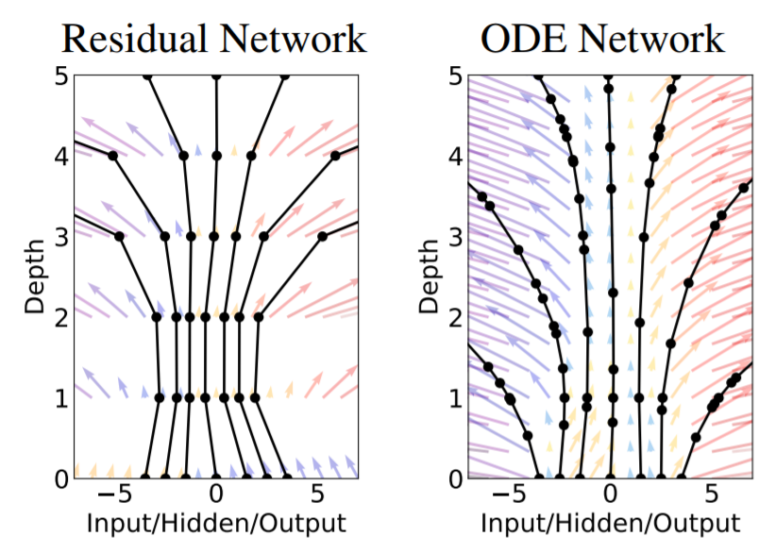
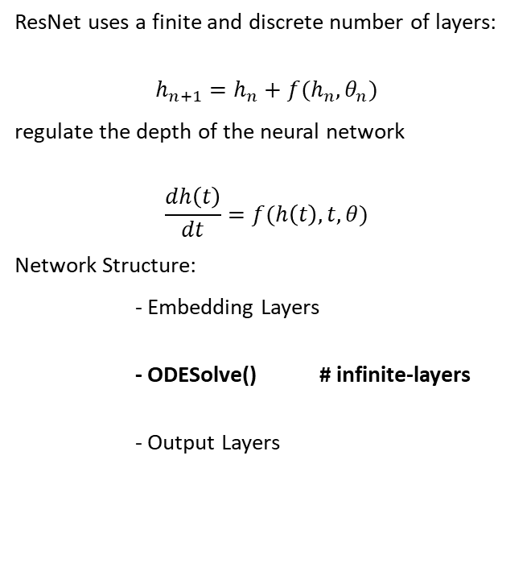
From ResNet to neural ordinary differential equations
ResNet uses a finite and discrete number of layers:
$$h_{n+1}=h_{n}+f(h_{n},θ_{n})$$
regulate the depth of the neural network
$$\frac{dh\left(t\right)}{dt}=f(h\left(t\right),t,θ)$$
Network Structure:
- Embedding Layers
- ODESolve() # infinite-layers
- Output Layers
arXiv:1806.07366 , Chen et al.
Notes:
While a ResNet uses a finite and discrete number of layers, i.e., index ‘t’ goes from 1 up to the number of layers (50, 150 and so on), an ODE net uses a continuous representation of the layers.
By looking deeper into the equation $h_{t+1}=h_{t}+f(h_{t},θ_{t})$, if we take each time a smaller step and add more layers in between, we can parametrize the dynamics of the hidden layers by an ODE: $\frac{dh\left(t\right)}{dt}=f(h\left(t\right),t,θ)$.
Thus, we can switch the hidden layers with an ODE solver, starting from $h\left(0\right)$ and up to the chosen output $h\left(T\right)$

Slide 10
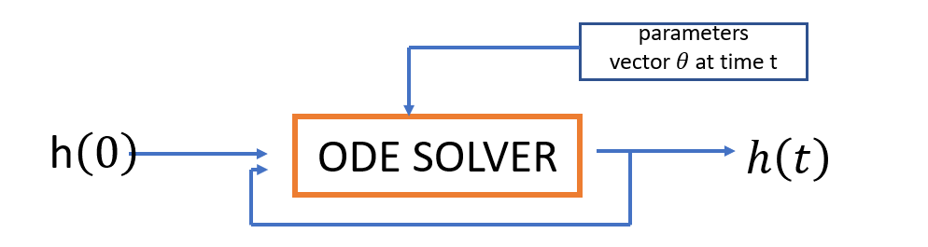
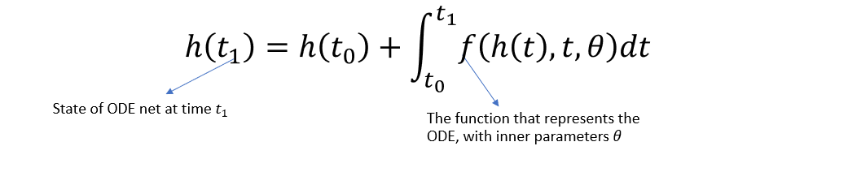
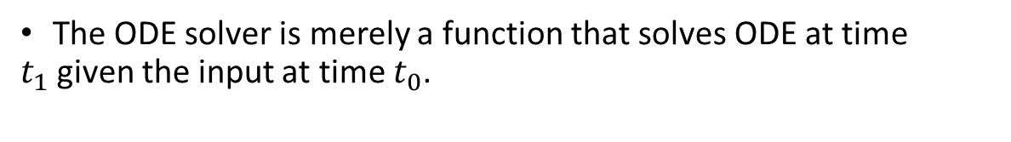
Neural ODE forward pass
The ODE solver is merely a function that solves ODE at time $t_{1}$given the input at time $t_{0}$.
arXiv:1806.07366 , Chen et al.

Slide 11
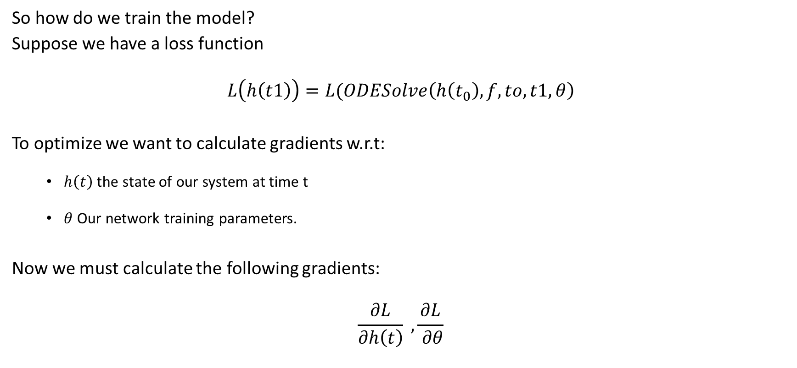
Neural ODE training and backward pass
So how do we train the model?
Suppose we have a loss function
$$L\left(h\left(t1\right)\right)=L(ODESolve\left(h\left(t_{0}\right), f,to,t1,θ\right)$$
To optimize we want to calculate gradients w.r.t:
$h\left(t\right)$the state of our system at time t
$θ$ Our network training parameters.
Now we must calculate the following gradients:
$$\frac{∂L}{∂h\left(t\right)} , \frac{∂L}{ ∂θ}$$

Slide 12
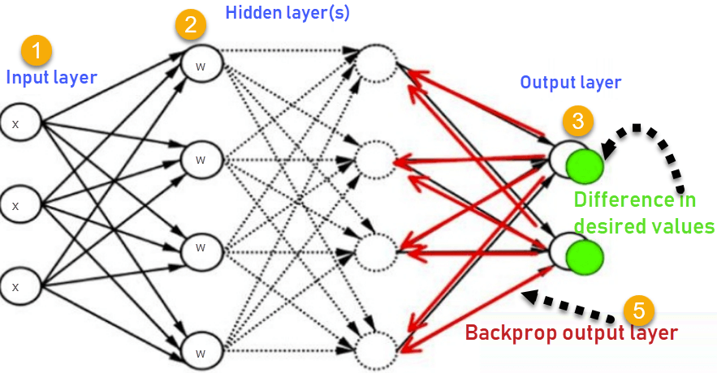
Neural ODE training and backward pass cont.
Backpropagation in DNNs:
How do we apply this to a “black box” ODE solver with so called infinite number of layers?
Notes:
Problem : we earlier stated that the network is almost continuous and contains a lot of h states, thus we have a lot of parameters $θ$ to store, and have a large memory cost

Slide 13
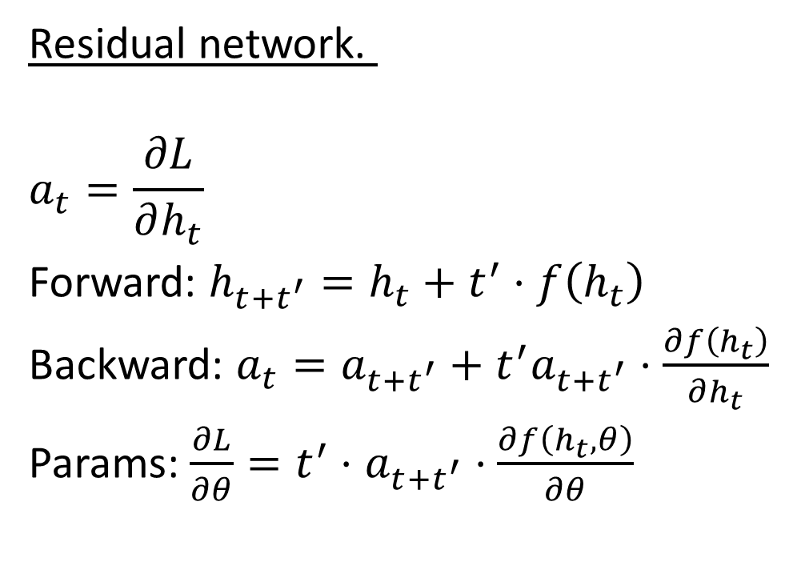
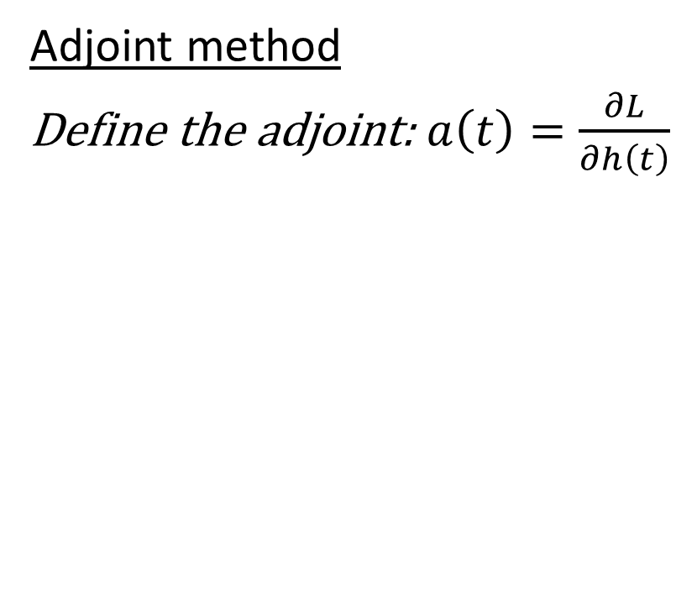
Adjoint sensitivity method continuous-time backpropagation
Residual network.
$$a_{t}=\frac{∂L}{∂h_{t}}$$
Forward: $h_{t+t^{′}}=h_{t}+t^{′}⋅f\left(h_{t}\right)$
Backward: $a_{t}=a_{t+t^{′}}+t^{′}a_{t+t^{′}}⋅\frac{∂f\left(h_{t}\right)}{∂h_{t}}$
Params: $\frac{∂L}{∂θ}=t^{′}⋅$ $a_{t+t^{′}}$ $⋅\frac{∂f\left(h_{t}, θ\right)}{∂θ}$
Adjoint method
Define the adjoint: $a\left(t\right)=\frac{∂L}{∂h\left(t\right)}$
arXiv:1806.07366 , Chen et al.
Notes:
We treat the ODE solver as a black box, and compute gradients using the adjoint sensitivity method.
1. We can see the forward pass and backward pass for ResNet. Let’s see the paper approach of calculating those for the Neural ODE.
This approach computes gradients by solving a second, augmented ODE backwards in time, and is applicable to all ODE solvers. How?

Slide 14
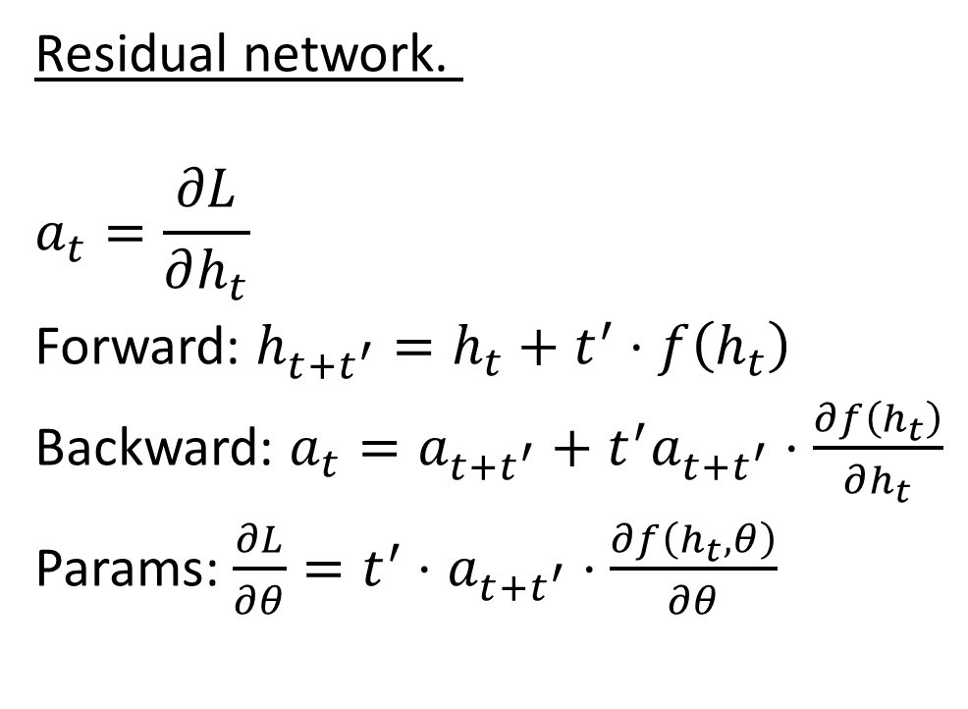
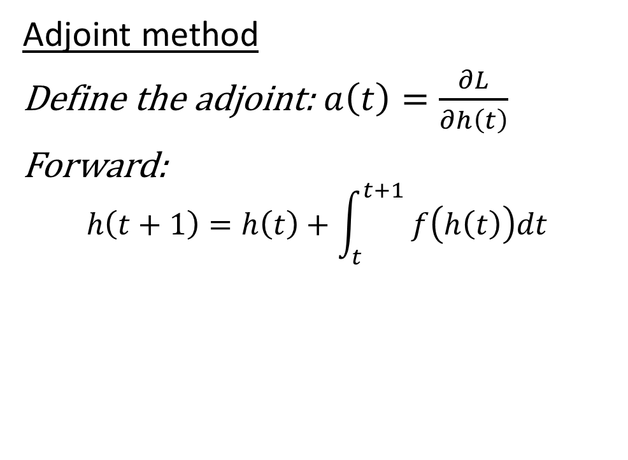
Adjoint sensitivity method Continuous-time Backpropagation
Residual network.
$$a_{t}=\frac{∂L}{∂h_{t}}$$
Forward: $h_{t+t^{′}}=h_{t}+t^{′}⋅f\left(h_{t}\right)$
Backward: $a_{t}=a_{t+t^{′}}+t^{′}a_{t+t^{′}}⋅\frac{∂f\left(h_{t}\right)}{∂h_{t}}$
Params: $\frac{∂L}{∂θ}=t^{′}⋅$ $a_{t+t^{′}}$ $⋅\frac{∂f\left(h_{t}, θ\right)}{∂θ}$
Adjoint method
Define the adjoint: $a\left(t\right)=\frac{∂L}{∂h\left(t\right)}$
Forward:
$$h\left(t+1\right)=h\left(t\right)+\int_{t}^{t+1}{ f\left(h\left(t\right)\right)dt }$$
arXiv:1806.07366 , Chen et al.
Notes:
The forward pass is as we saw explicitly by integrating and solve the ODE. We can use any ODE solver for this

Slide 15
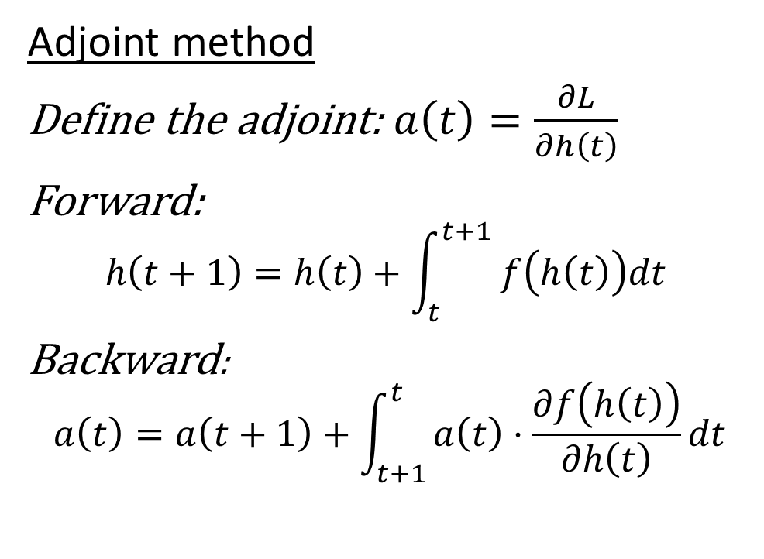
Adjoint sensitivity method Continuous-time Backpropagation
Residual network.
$$a_{t}=\frac{∂L}{∂h_{t}}$$
Forward: $h_{t+t^{′}}=h_{t}+t^{′}⋅f\left(h_{t}\right)$
Backward: $a_{t}=a_{t+t^{′}}+t^{′}a_{t+t^{′}}⋅\frac{∂f\left(h_{t}\right)}{∂h_{t}}$
Params: $\frac{∂L}{∂θ}=t^{′}⋅$ $a_{t+t^{′}}$ $⋅\frac{∂f\left(h_{t}, θ\right)}{∂θ}$
Adjoint method
Define the adjoint: $a\left(t\right)=\frac{∂L}{∂h\left(t\right)}$
Forward:
$$h\left(t+1\right)=h\left(t\right)+\int_{t}^{t+1}{ f\left(h\left(t\right)\right)dt }$$
Backward:
$$a\left(t\right)=a\left(t+1\right)+\int_{t+1}^{t}{a\left(t\right)⋅\frac{∂f\left(h\left(t\right)\right)}{∂h\left(t\right)}dt}$$
Adjoint state
Adjoint Differential Equation
arXiv:1806.07366 , Chen et al.
Notes:
To optimize L, we require gradients with respect to theta. The first step is to determining how the gradient of the loss depends on the hidden state
z(t) at each instant. The adjoint dynamics are given by another ODE, which can be thought of as the instantaneous analog of the chain rule (Backward equation)

Slide 16
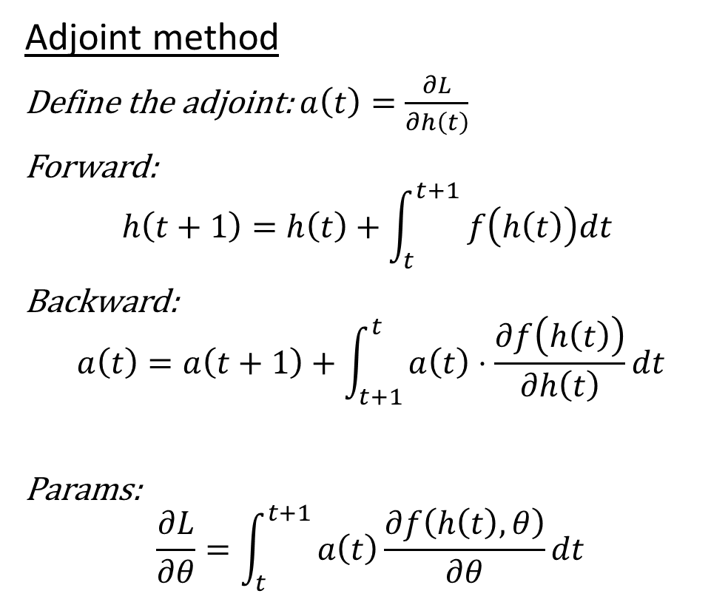
Adjoint sensitivity method Continuous-time Backpropagation
Adjoint method
Define the adjoint: $a\left(t\right)=\frac{∂L}{∂h\left(t\right)}$
Forward:
$$h\left(t+1\right)=h\left(t\right)+\int_{t}^{t+1}{ f\left(h\left(t\right)\right)dt }$$
Backward:
$$a\left(t\right)=a\left(t+1\right)+\int_{t+1}^{t}{a\left(t\right)⋅\frac{∂f\left(h\left(t\right)\right)}{∂h\left(t\right)}dt}$$
Params:
$$\frac{∂L}{∂θ}=\int_{t}^{t+1}{a\left(t\right)\frac{∂f\left(h\left(t\right),θ\right)}{∂θ}dt}$$
Residual network.
$$a_{t}=\frac{∂L}{∂h_{t}}$$
Forward: $h_{t+t^{′}}=h_{t}+t^{′}⋅f\left(h_{t}\right)$
Backward: $a_{t}=a_{t+t^{′}}+t^{′}a_{t+t^{′}}⋅\frac{∂f\left(h_{t}\right)}{∂h_{t}}$
Params: $\frac{∂L}{∂θ}=t^{′}⋅$ $a_{t+t^{′}}$ $⋅\frac{∂f\left(h_{t}, θ\right)}{∂θ}$
Adjoint state
Adjoint Differential Equation
arXiv:1806.07366 , Chen et al.
Notes:
Computing the gradients with respect to the parameters requires evaluating a third integral, which depends on both z(t) and the adjoint a(t).
Automatic differentiation is also called algorithmic differentiation or in short AutoDiff is a set of techniques to evaluate the derivative of a function specified by a computer program.
Params expression and backward expression can be efficiently evaluated by automatic differentiation, at a time cost similar to that of evaluating f.

Slide 17
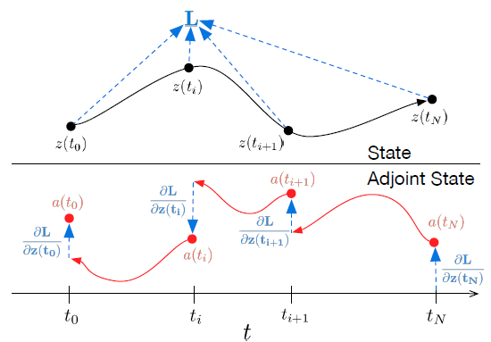
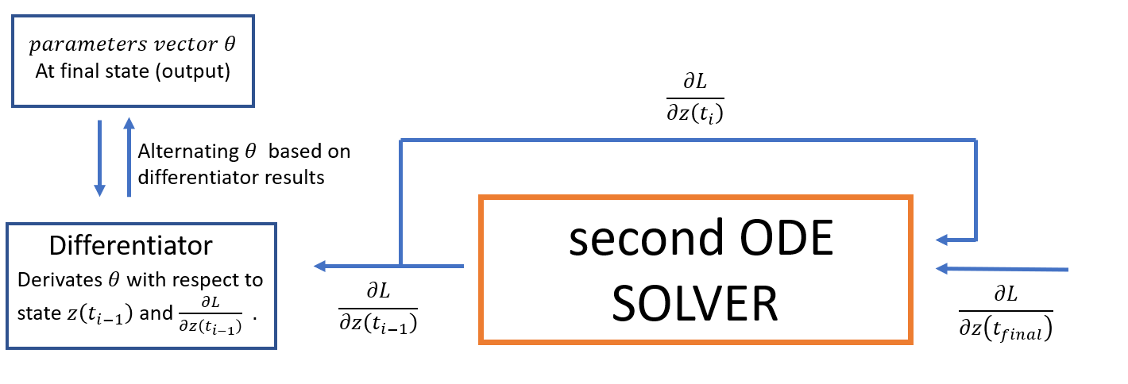
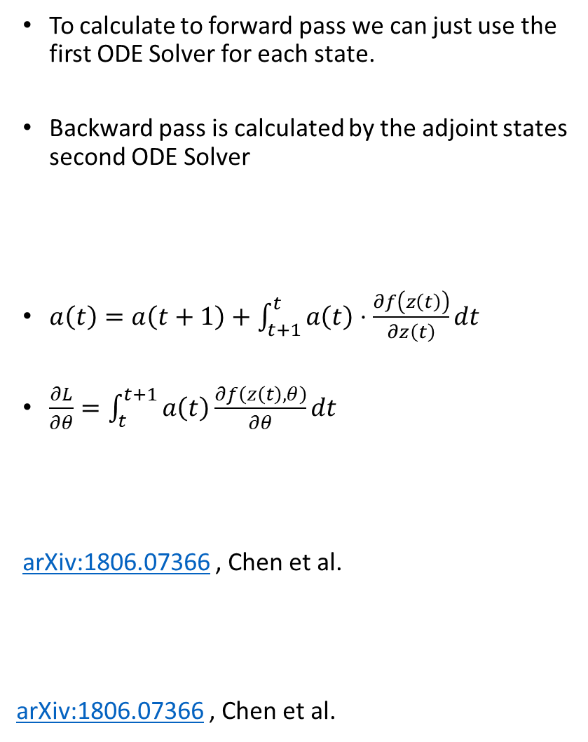
Adjoint sensitivity method continuous-time backpropagation
To calculate to forward pass we can just use the first ODE Solver for each state.
Backward pass is calculated by the adjoint states second ODE Solver
$a\left(t\right)=a\left(t+1\right)+\int_{t+1}^{t}{a\left(t\right)⋅\frac{∂f\left(z\left(t\right)\right)}{∂z\left(t\right)}dt}$
$\frac{∂L}{∂θ}=\int_{t}^{t+1}{a\left(t\right)\frac{∂f\left(z\left(t\right),θ\right)}{∂θ}dt}$
arXiv:1806.07366 , Chen et al.
arXiv:1806.07366 , Chen et al.
Notes:
Here is a visualization to how we work and train this neural network.
- First there is of course the forward pass which is calculated using the ODE solver.
- Second curve can be calculated using a second ODE Solver.
Second ODE solver basically calculated the Adjoint state at time t, which means how does the loss depends on the hidden state at time t.
We know how derivatives of the adjoint develops through time, means we know the sensitivity of the loss w.r.t to the hidden state at each time. this is the source to the name adjoint sensitivity method. This way we can go backwards and integrate through time to get the adjoint at each time. This is the continuous analog to the chain rule.

Slide 18
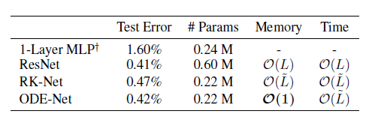
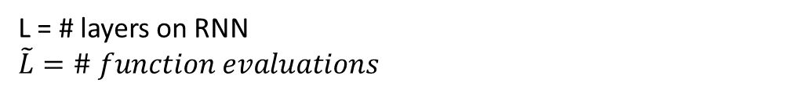
Results and Benefits of ODE-nets
ODE networks have some useful properties:
Memory efficiency – Similar results on MNIST compared to ResNet with 1/3 the parameters
ODE solvers take a tolerance level as an argument- This controls how accurate the solution is at the cost of more function evaluations.
The variable time step aspect can be used for continuous time-series models, unlike RNNs which have inputs at fixed intervals of time.
L = # layers on RNN
$$\tilde{L}=\# function evaluations$$
arXiv:1806.07366 , Chen et al.
Notes:
ODE networks have some really useful properties:
They are much more memory efficient compared to conventional ResNets. An ODE-net achieves the same performance as a ResNet on MNIST classification with roughly 3 times fewer parameters.
An aspect I haven’t talked about is tolerance or error in ODE solvers. ODE solvers take a tolerance level as an argument while solving, which controls how accurate the solution is at the cost of more function evaluations. This can be used as a tradeoff between performance and speed. For example, ODE-nets can be trained with very low tolerance values which can be later relaxed at test time for faster inference.
The variable time step aspect can be used for continuous time-series models, unlike RNNs which have inputs at fixed intervals of time.
Possibly the most impactful benefit is in continuous normalizing flows. A high level description is that the continuous nature of the ODE-net as opposed to a discrete network greatly simplifies and speeds up certain computations in training. I won’t go into more details now, as this topic deserves a whole post on its own.

Slide 19
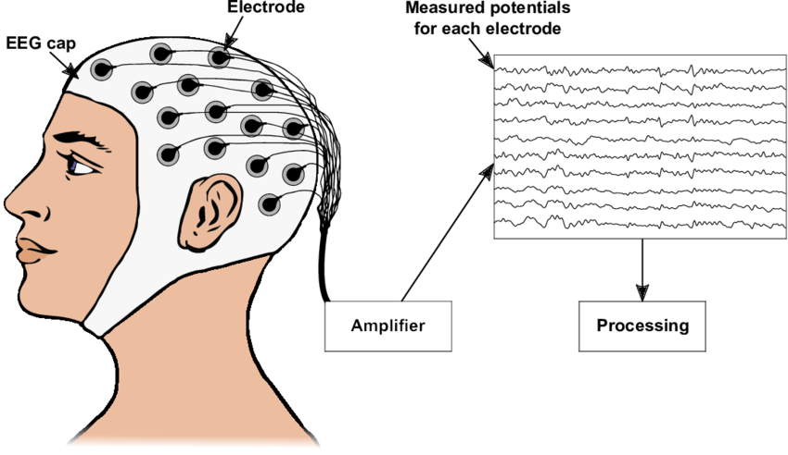
The Data

Slide 20
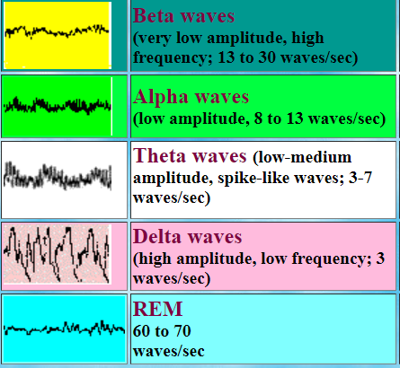
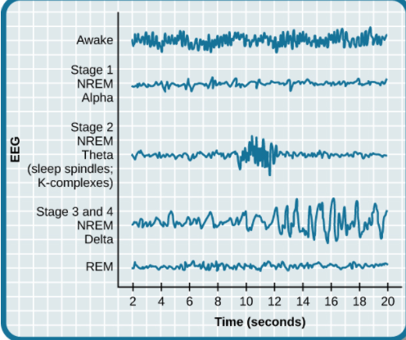
The data Sleeping stages
Beta waves – the person is awake
Alpha waves – The person is awake and relaxed with closed eyes
Theta waves – The person is sleepy/ already sleeping.
Delta waves – The person is in deep sleep state.
REM (Rapid eye movement) – Paradoxal, deep sleep but similar to wake patterns, the person is probably dreaming.
Notes:
The first stage of NREM sleep is known as stage 1 sleep. Stage 1 sleep is a transitional phase that occurs between wakefulness and sleep In terms of brain wave activity, stage 1 sleep is associated with both alpha and theta waves. The early portion of stage 1 sleep produces alpha waves, which are relatively low frequency (8–13Hz), high amplitude patterns of electrical activity (waves) that become synchronized ([link]). This pattern of brain wave activity resembles that of someone who is very relaxed yet awake. As an individual continues through stage 1 sleep, there is an increase in theta wave activity.
As we move into stage 2 sleep, the body goes into a state of deep relaxation. Theta waves still dominate the activity of the brain, but they are interrupted by brief bursts of activity known as sleep spindles. A sleep spindle is a rapid burst of higher frequency brain waves that may be important for learning and memory In addition, the appearance of K-complexes is often associated with stage 2 sleep. A K-complex is a very high amplitude pattern of brain activity that may in some cases occur in response to environmental stimuli.
Stage 3 and stage 4 of sleep are often referred to as deep sleep or slow-wave sleep because these stages are characterized by low frequency (up to 4 Hz), high amplitude delta waves
As mentioned earlier, REM sleep is marked by rapid movements of the eyes. The brain waves associated with this stage of sleep are very similar to those observed when a person is awake, as shown in [link], and this is the period of sleep in which dreaming occurs.

Slide 21
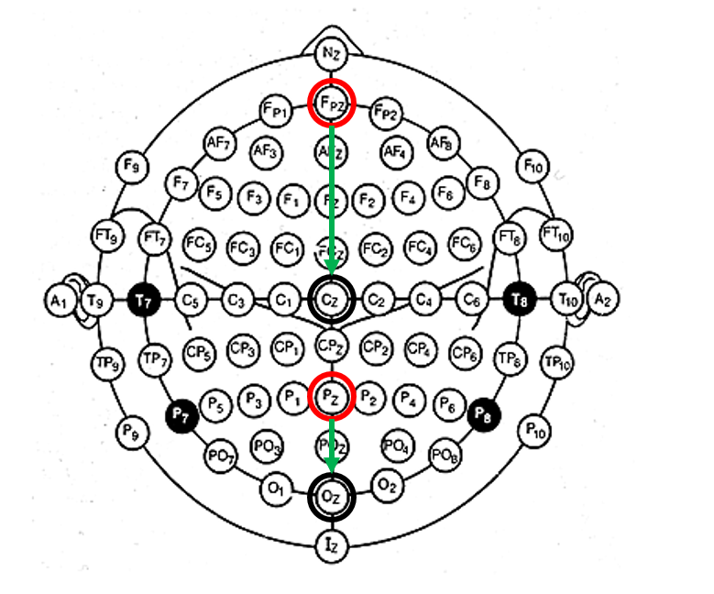
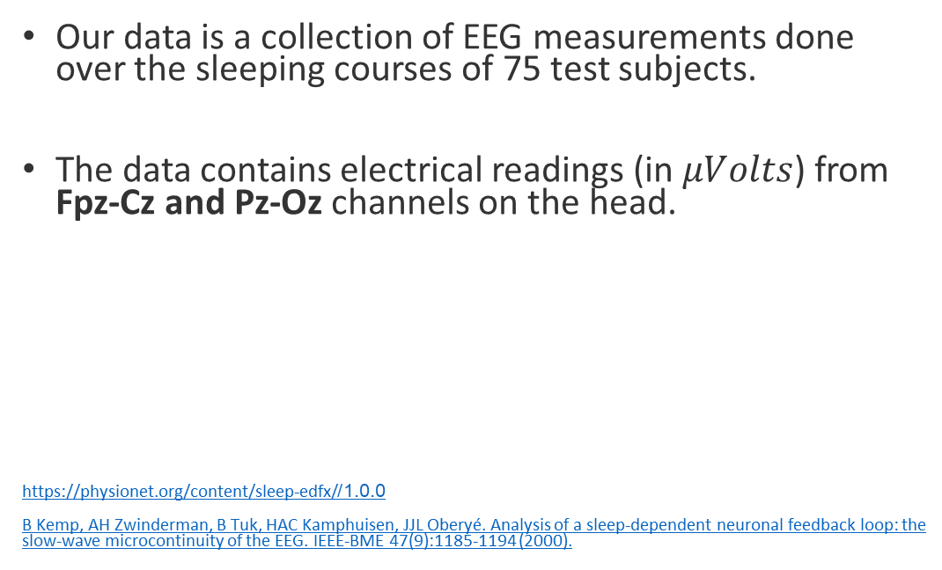
The data
Our data is a collection of EEG measurements done over the sleeping courses of 75 test subjects.
The data contains electrical readings (in $μVolts$) from Fpz-Cz and Pz-Oz channels on the head.
https://physionet.org/content/sleep-edfx/1.0.0/
B Kemp, AH Zwinderman, B Tuk, HAC Kamphuisen, JJL Oberyé. Analysis of a sleep-dependent neuronal feedback loop: the slow-wave microcontinuity of the EEG. IEEE-BME 47(9):1185-1194 (2000).

Slide 22
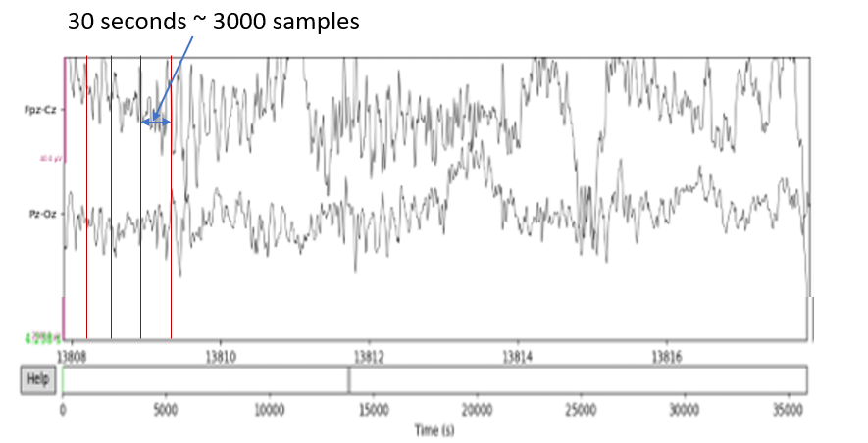
The data
Fs = 100 Hz
The data is divided to 30 seconds of sleeping epochs.
Each epoch is labeled in one out of 5 sleeping stages
(W, S1, S2, S3&4, REM)

Slide 23
The data
Fs = 100 Hz
The data is divided into Epochs of 30 seconds each.
Each epoch is labeled in one out of 5 sleeping stages
(W, S1, S2, S3&4, REM)
Single sleeping epoch:
2 channels x 3000 samples | Label

Slide 24
The data
Fs = 100 Hz
The data is divided into Epochs of 30 seconds each.
Each epoch is labeled in one out of 5 sleeping stages
(W, S1, S2, S3&4, REM)
Single sleeping epoch:
Test – Train split:
2 channels x 3000 samples | Label
80%
20%
Epoch 1 | Epoch 2 | …

Slide 25
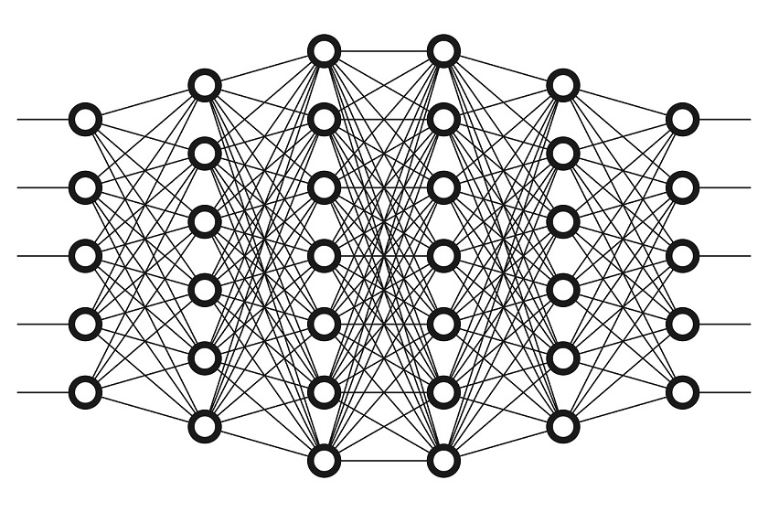
The Model

Slide 26
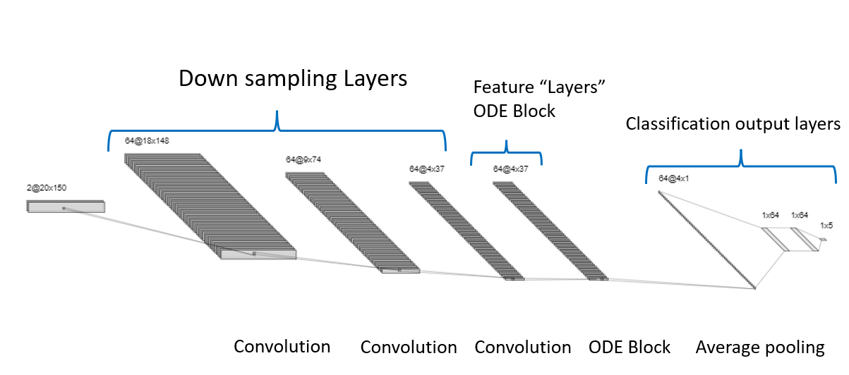
Basic model The architecture
ODE block consists of:
ODE function:
Norm layer
ReLU
Convolutional layer
Norm layer
ReLU
Convolutional layer
Norm layer
Tolerance parameters and ODE solver

Slide 27
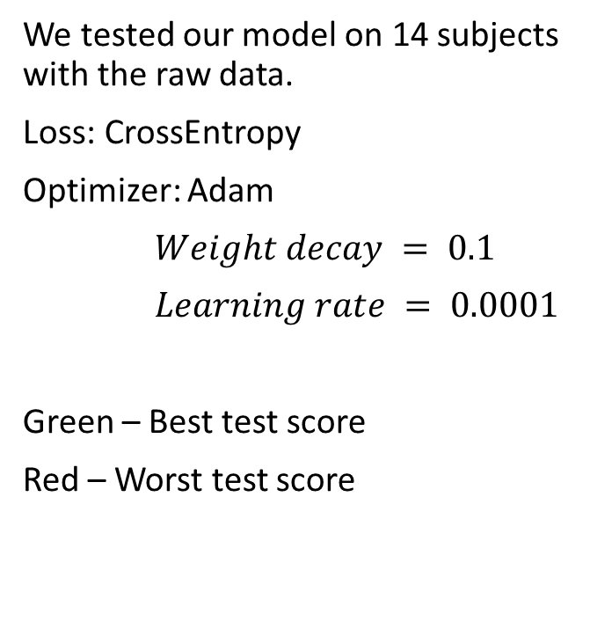
Preliminary results over 14 test subjects Sleeping stage classification accuracy
We tested our model on 14 subjects with the raw data.
Loss: CrossEntropy
Optimizer: Adam
$Weight decay = 0.1$
$Learning rate = 0.0001$
Green – Best test score
Red – Worst test score
ID | subject | train accuracy | test accuracy
1 | SC4001E0 | 0.4829 | 0.4702
2 | SC4011E0 | 0.6251 | 0.6091
3 | SC4021E0 | 0.6748 | 0.6029
4 | SC4031E0 | 0.6601 | 0.6526
5 | SC4041E0 | 0.5703 | 0.5325
6 | SC4051E0 | 0.619 | 0.5149
7 | SC4071E0 | 0.7478 | 0.6103
8 | SC4081E0 | 0.3073 | 0.3142
9 | SC4091E0 | 0.596 | 0.5708
10 | SC4101E0 | 0.6165 | 0.5727
11 | SC4111E0 | 0.6137 | 0.5838
12 | SC4121E0 | 0.6366 | 0.519
13 | SC4131E0 | 0.6501 | 0.5854
14 | SC4141E0 | 0.6119 | 0.62

Slide 28
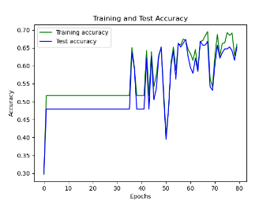
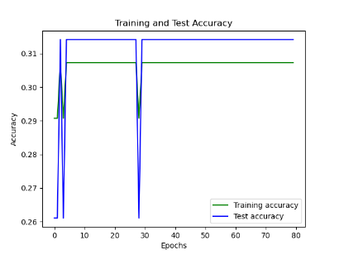
Preliminary results over 14 test subjects Cont.
ID | subject | train accuracy | test accuracy
ID | subject | train accuracy | test accuracy
4 | SC4031E0 | 0.6601 | 0.6526
8 | SC4081E0 | 0.3073 | 0.3142

Slide 29
Next steps
Use all subjects and data available for training.
Do preprocessing and feature engineering that are fitting to sleeping stages data.
Improve model architecture and tune
hyperparameters for optimal results.

Slide 30
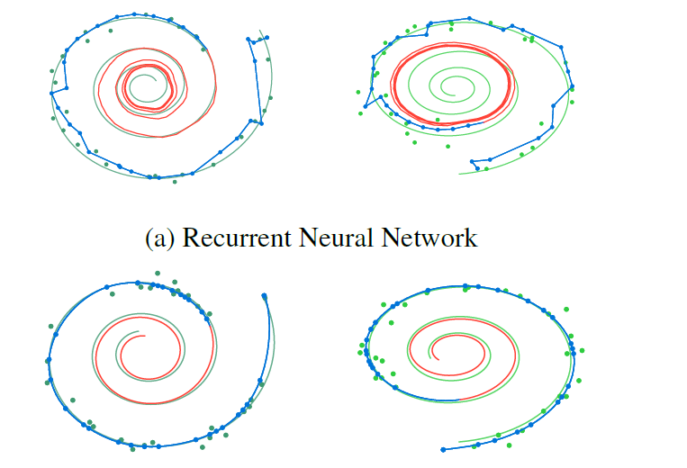
Next steps cont.
Extrapolation of the data for prediction of the sleeping stages.
arXiv:1806.07366 , Chen et al.

Slide 31
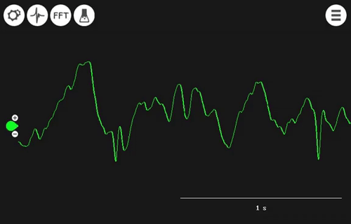
https://github.com/orelts/Sleep-Stage-Prediction-Classification-Using-Neural-ODE

